Slide 1
High-Dimensional Box-Cox

Slide 2
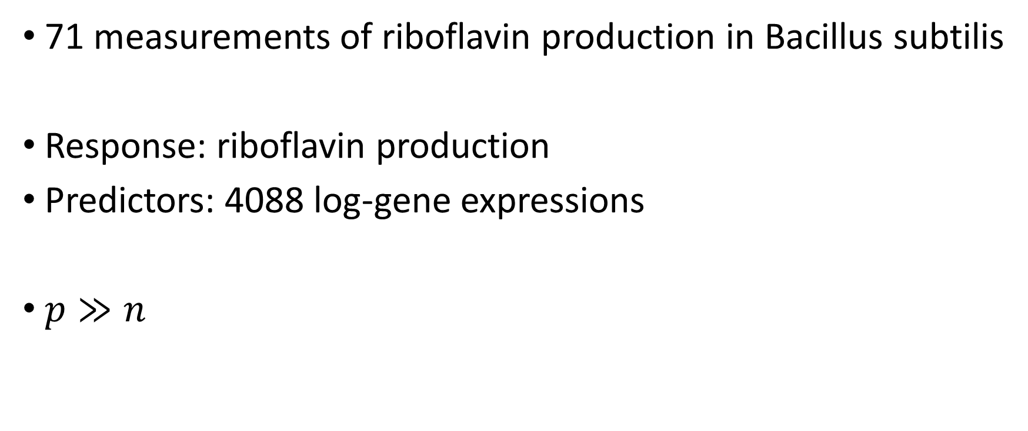
Riboflavin Data
71 measurements of riboflavin production in Bacillus subtilis
Response: riboflavin production
Predictors: 4088 log-gene expressions
$p≫n$

Slide 3
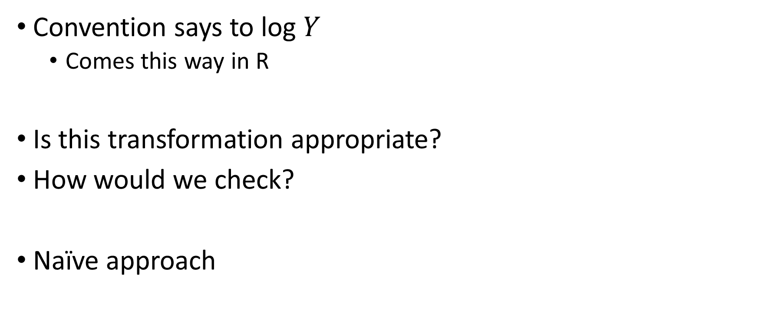
Riboflavin Data
Convention says to log $Y$
Comes this way in R
Is this transformation appropriate?
How would we check?
Naïve approach

Slide 4
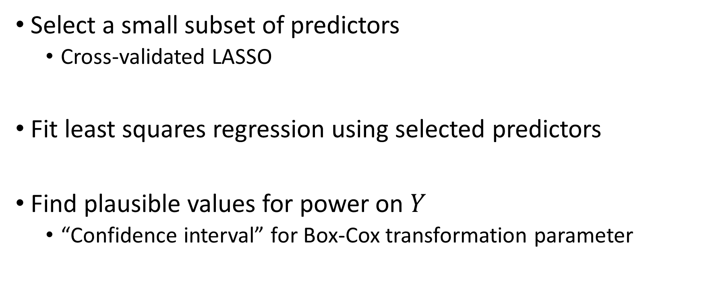
Riboflavin Data
Select a small subset of predictors
Cross-validated LASSO
Fit least squares regression using selected predictors
Find plausible values for power on $Y$
“Confidence interval” for Box-Cox transformation parameter
Notes:
Log corresponds to $Y^{0}$

Slide 5
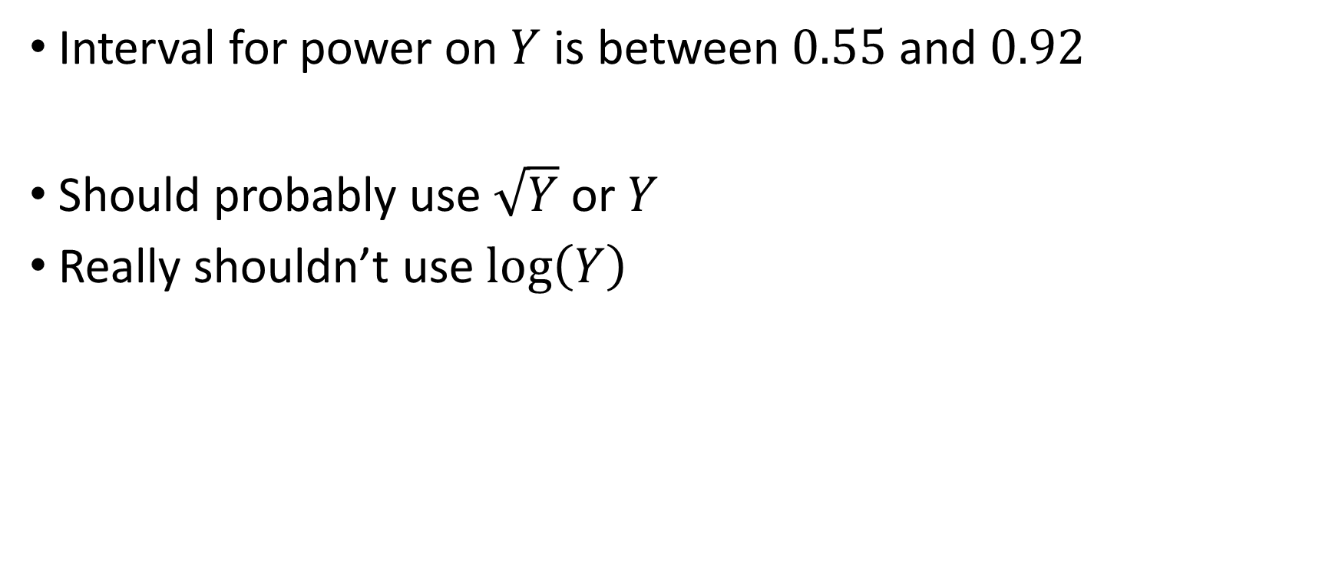
Riboflavin Data
Interval for power on $Y$ is between $0.55$ and $0.92$
Should probably use $\sqrt{Y}$ or $Y$
Really shouldn’t use $\log\left(Y\right)$

Slide 6
Riboflavin Data
Disclaimer: This isn’t inference!
Suggests that conventional wisdom may be wrong
Need a more principled approach

Slide 7

Box-Cox Framework
Usual regression model
$$Z=Xβ+σε$$
$$ε∼N\left(0,I\right)$$
Observe $X$ and $Y$, a transformation of $Z$
$$Y=h^{−1}(Z)$$

Slide 8
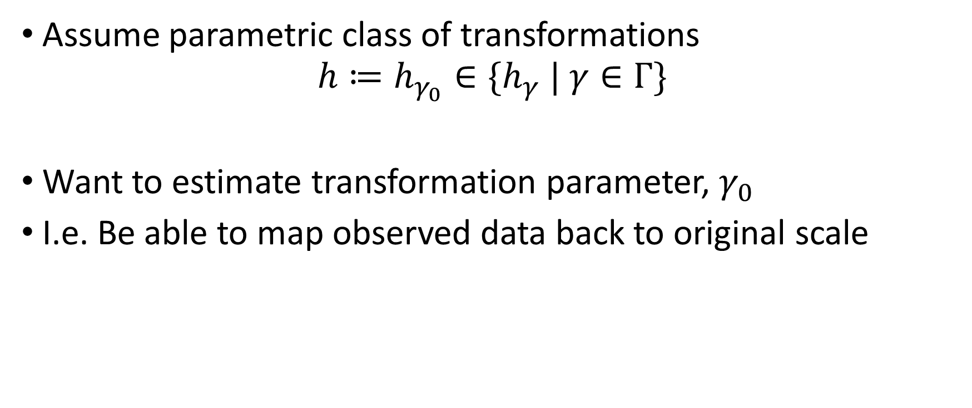
Box-Cox Framework
Assume parametric class of transformations
$$h≔h_{γ_{0}}∈\{h_{γ} | γ∈Γ\}$$
Want to estimate transformation parameter, $γ_{0}$
I.e. Be able to map observed data back to original scale
Notes:
$γ_{0}$ is often of interest both for statistical and scientific reasons

Slide 9

Box-Cox Framework
One popular class of transformations (Box and Cox, 1964):
$$h_{γ}\left(Y\right)= \left\{\begin{aligned}\frac{Y^{γ}−1}{γ} \text{if} γ≠0 \\ \log\left(Y\right) \text{if} γ=0\end{aligned}\right.$$

Slide 10

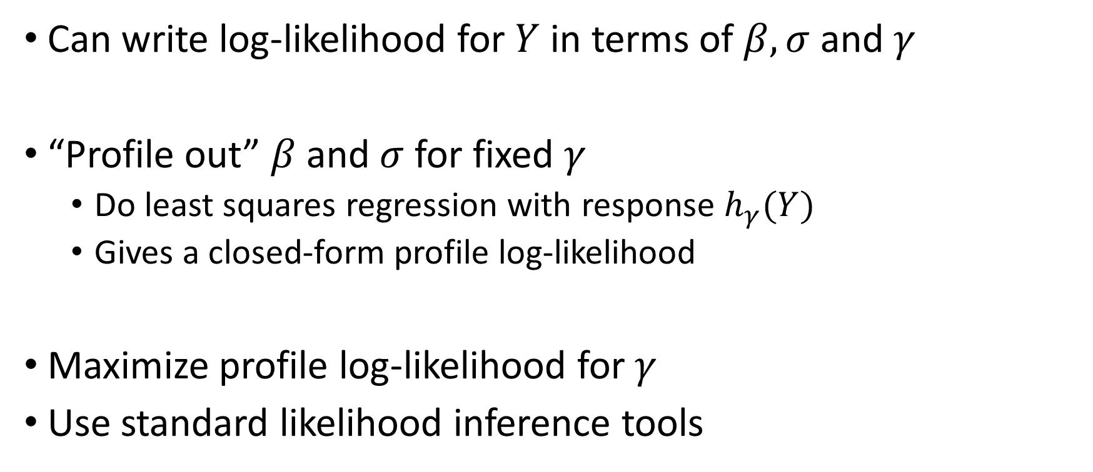
Estimating $γ$
Can write log-likelihood for $Y$ in terms of $β,σ$ and $γ$
“Profile out” $β$ and $σ$ for fixed $γ$
Do least squares regression with response $h_{γ}(Y)$
Gives a closed-form profile log-likelihood
Maximize profile log-likelihood for $γ$
Use standard likelihood inference tools
Notes:
Mention that “profile out” means “optimize over”

Slide 11
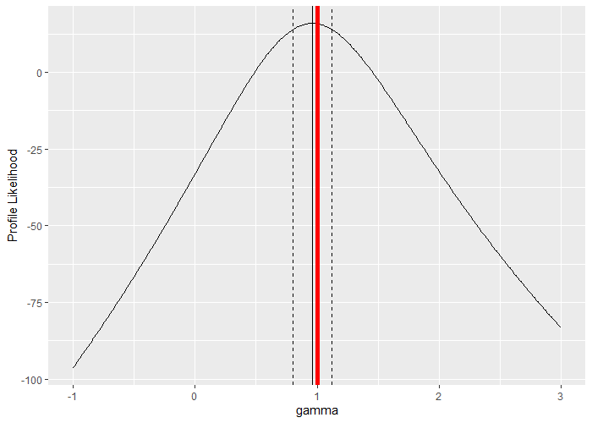
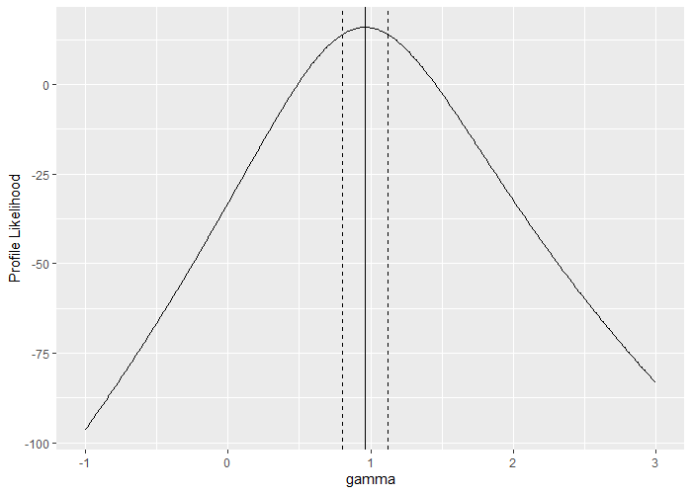
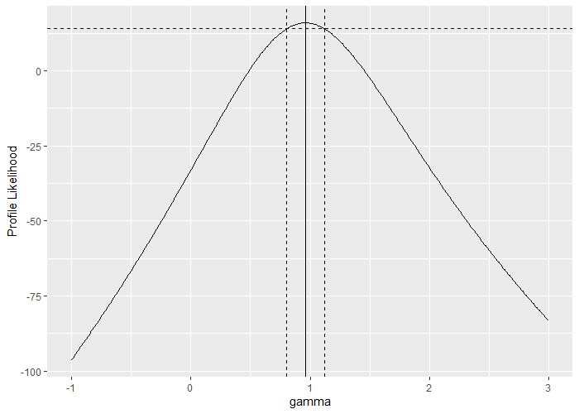
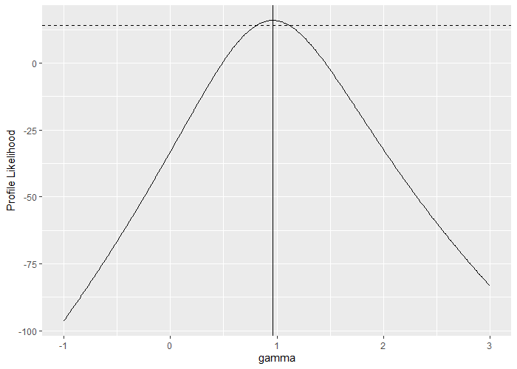


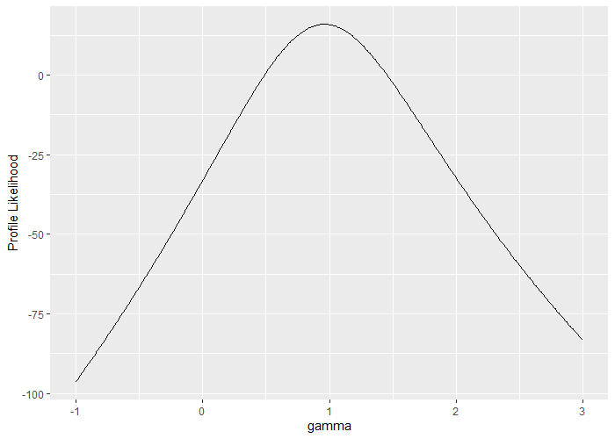
Estimating $γ$

Slide 12
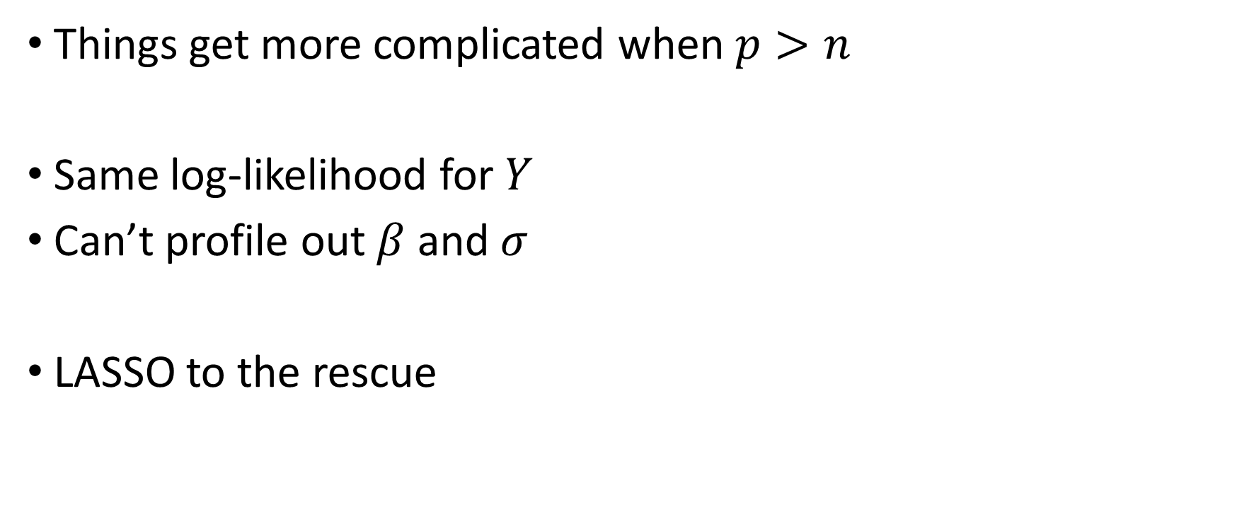
High Dimension
Things get more complicated when $p>n$
Same log-likelihood for $Y$
Can’t profile out $β$ and $σ$
LASSO to the rescue

Slide 13
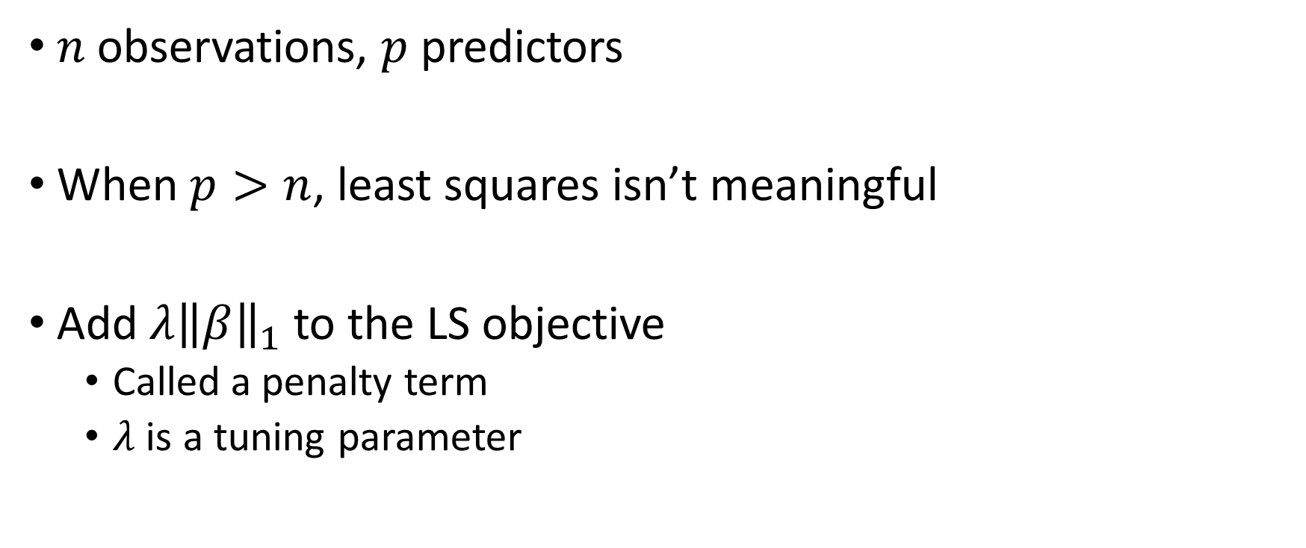
The LASSO
$n$ observations, $p$ predictors
When $p>n$, least squares isn’t meaningful
Add $λ{\left\|β\right\|}_{1}$ to the LS objective
Called a penalty term
$λ$ is a tuning parameter
Notes:
$λ$ chosen by CV 1SE throughout presentation

Slide 14
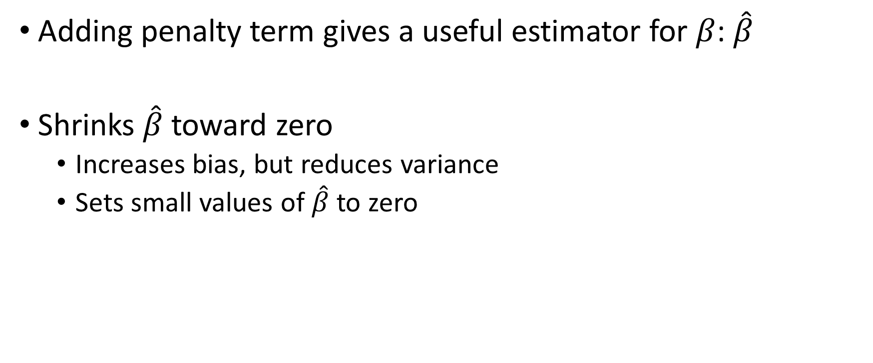
The LASSO
Adding penalty term gives a useful estimator for $β$: $\hat{β}$
Shrinks $\hat{β}$ toward zero
Increases bias, but reduces variance
Sets small values of $\hat{β}$ to zero

Slide 15
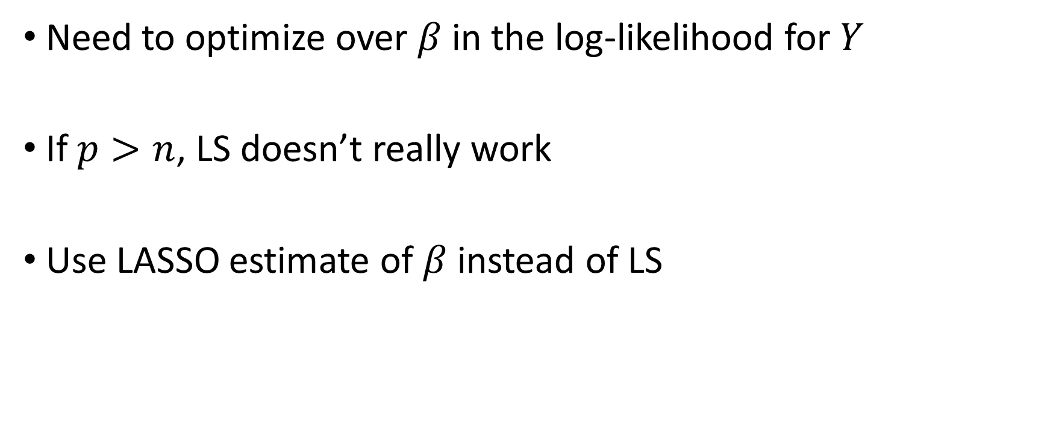
LASSO with Box-Cox
Need to optimize over $β$ in the log-likelihood for $Y$
If $p>n$, LS doesn’t really work
Use LASSO estimate of $β$ instead of LS

Slide 16
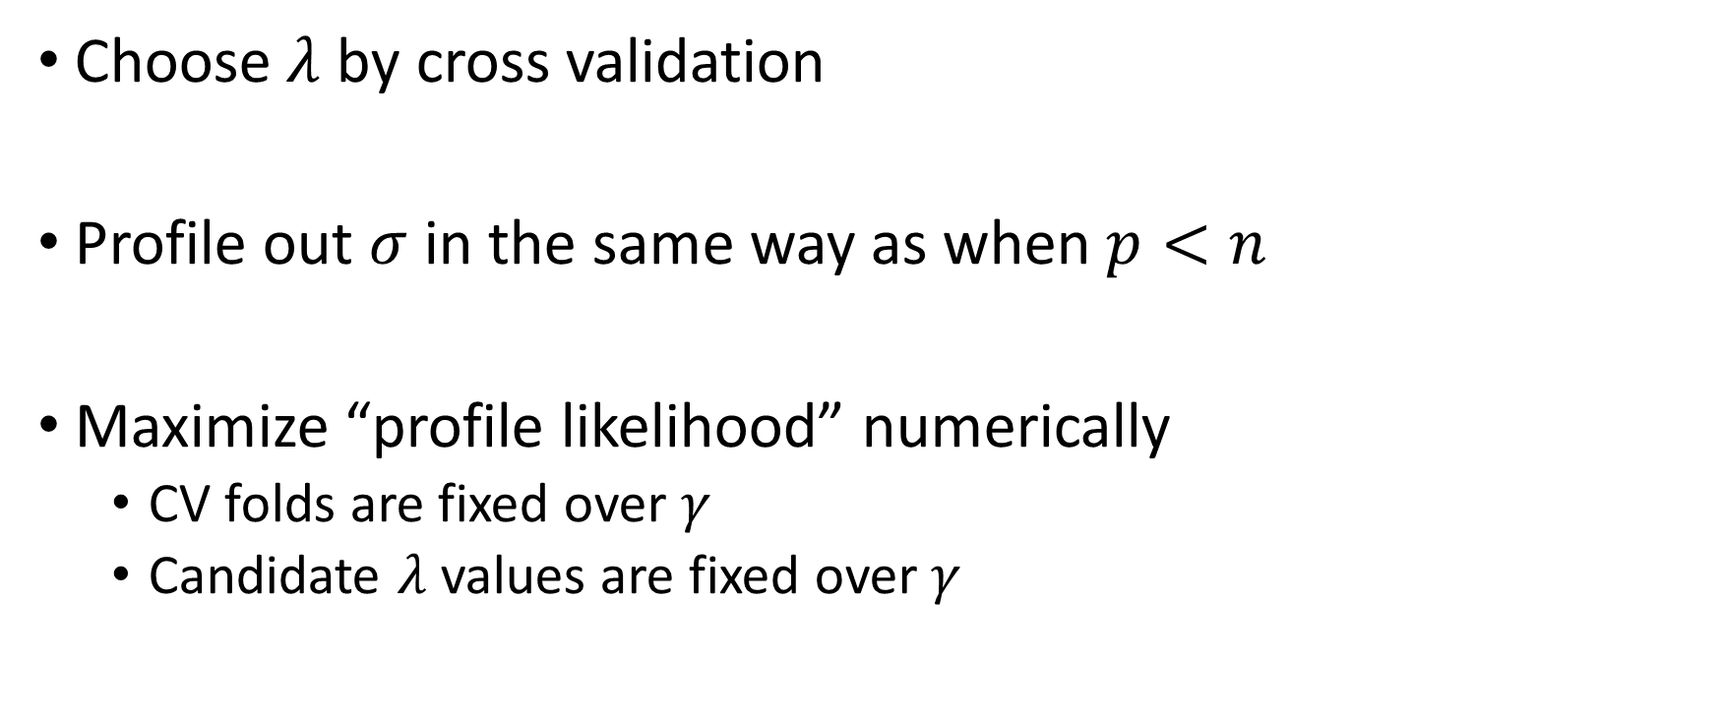
LASSO with Box-Cox
Choose $λ$ by cross validation
Profile out $σ$ in the same way as when $p<n$
Maximize “profile likelihood” numerically
CV folds are fixed over $γ$
Candidate $λ$ values are fixed over $γ$

Slide 17
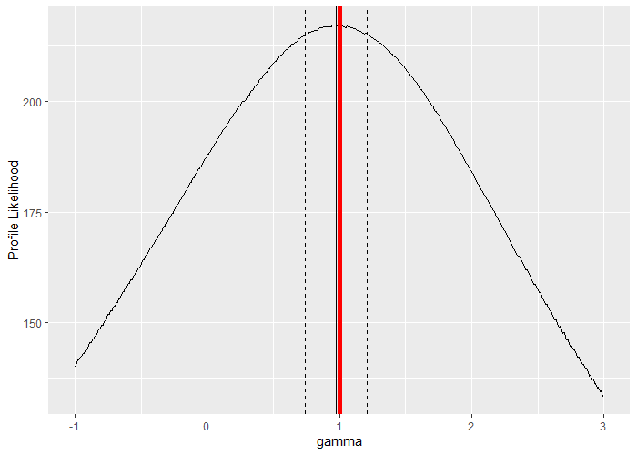
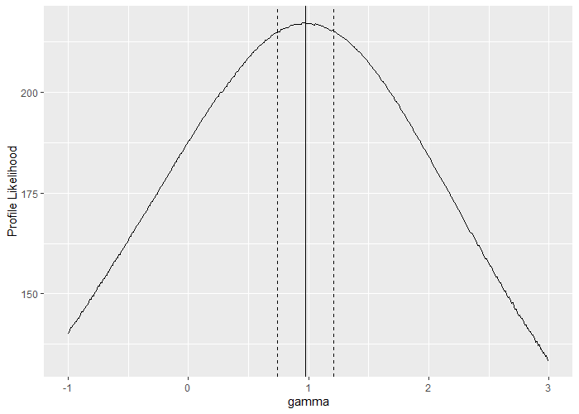
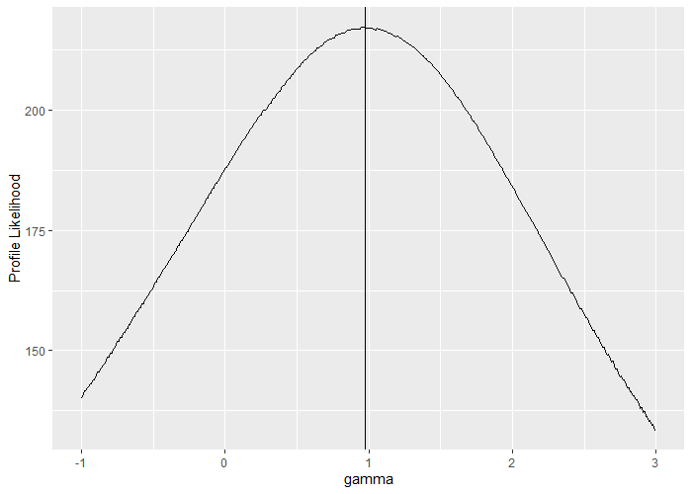


LASSO with Box-Cox

Slide 18
Box-Cox Inference
LS Box-Cox methodology gives confidence intervals
We can apply the same process with LASSO
Still a work in progress
Some empirical results

Slide 19
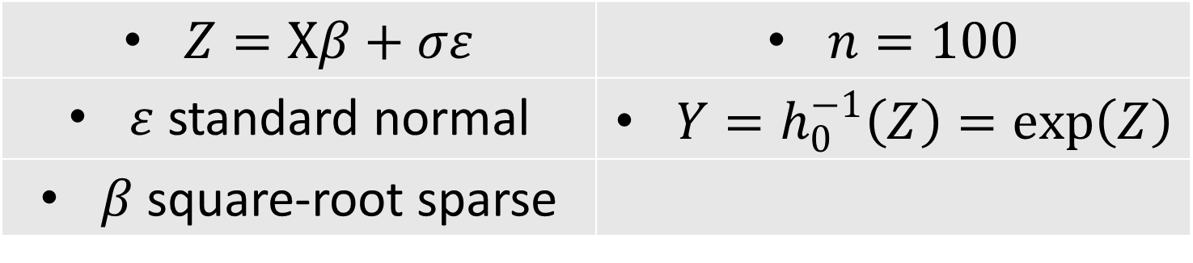

Box-Cox Inference
Maximize profile likelihood
Include all $γ$ with likelihood within $\sim 2$ of maximum
$Z=Xβ+σε$ | $n=100$
$ε$ standard normal | $Y=h_{0}^{−1}\left(Z\right)=\exp\left(Z\right)$
$β$ square-root sparse

Slide 20
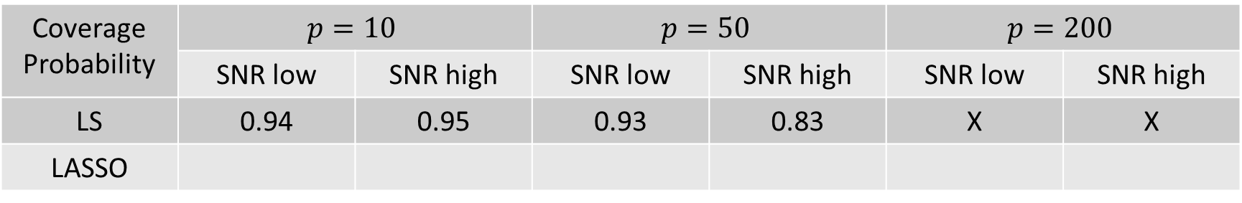
Box-Cox Inference
Coverage Probability | $$p=10$$ |  | $$p=50$$ |  | $$p=200$$
 | SNR low | SNR high | SNR low | SNR high | SNR low | SNR high
LS | 0.94 | 0.95 | 0.93 | 0.83 | X | X
LASSO
$Z=Xβ+σε$ | $n=100$
$ε$ standard normal | $Y=h_{0}^{−1}\left(Z\right)=\exp\left(Z\right)$
$β$ square-root sparse

